Slide 1
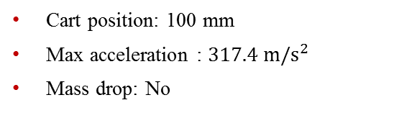
Datasets
High-Rate Overview
Benchmark
Applications
Datasets
Dataset 5 – test 11
Excitations:
Static cart action
Single hammer impact
Electromagnet mass
Cart position: 100 mm
Max acceleration : $317.4 m/s^{2}$
Mass drop: No

Slide 2
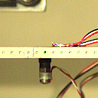
Datasets
High-Rate Overview
Benchmark
Applications
Datasets
Dataset 5 – test 11
Excitations:
Static cart action
Single hammer impact
Electromagnet mass
Cart position: 100 mm
Max acceleration : $317.4 m/s^{2}$
Mass drop: No

Slide 3

Datasets
High-Rate Overview
Benchmark
Applications
Datasets
Dataset 5 – test 12
Excitations:
Static cart action
Single hammer impact
Electromagnet mass
Cart position: 100 mm
Max acceleration : $173.3 m/s^{2}$
Mass drop: No

Slide 4

Datasets
High-Rate Overview
Benchmark
Applications
Datasets
Dataset 5 – test 12
Excitations:
Static cart action
Single hammer impact
Electromagnet mass
Cart position: 100 mm
Max acceleration : $173.3 m/s^{2}$
Mass drop: No

